Slide 1
Introduction to Money:
Contents:
Evolution of money
Barter system
Functions of money
Importance and role of money
Why study money?
Concepts of money
Money and national income and product
Economic disadvantages of money
Currency devaluation in Pakistan
Distinction between money and credit
Money as an assets
Concept of near money
Principles and method of note issue
Method of note issue in Pakistan

Slide 2
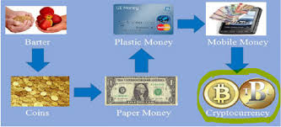
Money: Money is anything which is used as a medium of exchange.
Evolution of money:
The origin of money is lost.
Hunting society, skin of animals were used as a source of money.
The word “money” is derived from the Latin word “ Monet”.
Pastoral society used livestock.
Agricultural society used grain and foods.
The roman used cattle and salt.
Money was developed according to needs and requirements.
Main aim was to remove the short comings of the barter system.

Slide 3
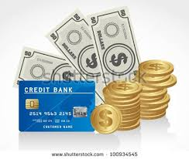
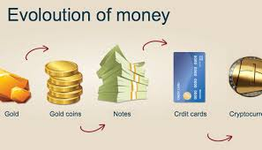
Different stages of evolution of money
Commodity money
Metallic money
Paper money
Credit money
Electronic money

Slide 4
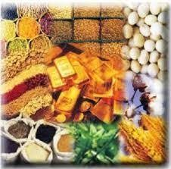
Commodity money:
Commodity money is money whose value comes from a commodity of which it is made. Commodity money consists of objects that have value in themselves (intrinsic value) as well as value in their use as money.
For example:
Cow, goats, axes, dried fishes etc. were used as a medium of exchange.

Slide 5
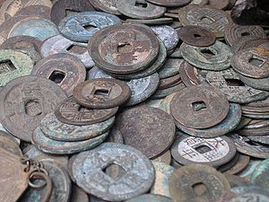
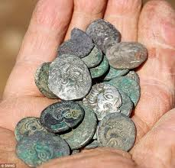
Metallic money:
Money made of any metal is called metallic money. It refers to coins made of various metals like gold, silver, nickel, copper, etc.
a) Standard or full-bodied coins – full-bodied coins are those face values is equal to their intrinsic value.
b) Token coins – token coins are those whose face value is higher than their intrinsic value is the value of the metal content present in the coin.

Slide 6
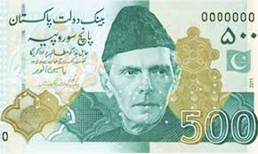
Paper money:
Paper money is a country's official, paper currency that is circulated for transaction-related purposes of goods and services. The printing of paper money is typically regulated by a country's central bank/treasury in order to keep the flow of funds in line with monetary policy.
Types of Paper Money:
There are basically four different Types of paper money, which is using in all over the world:
Representative Money.
Convertible paper money.
Inconvertible paper money
Fiat money

Slide 7
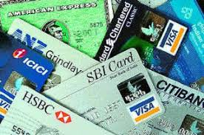
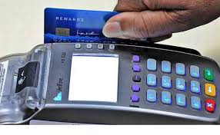
Credit money: Credit money includes bank money (different instruments offered by the banks).This type of money are convenient, safe and easily convertible into cash. Example: Cheques, drafts, etc.
Plastic money:
Electronic money (also known as e-money, electronic cash, electronic currency, digital money, digital cash or digital currency) refers to money or scrip which is exchanged only electronically. Typically, this involves use of computer networks, the internet and digital stored value systems.

Slide 8
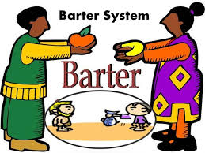
Barter system According to R.H.Parker: Barter is the direct exchange of goods and services without the use of money as either the means of payment or a unit of account.
Inconveniences of barter system:
Double coincidence of wants
No measure of value
No subdivision
No store of value
Standard of deferred payments
No investment
Economic measurements
Comparison of living standards
Tax collection

Slide 9
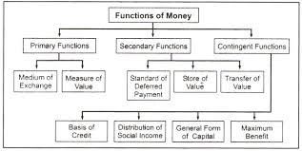
Functions of money
In todays world money performs variety of vital functions which are as follow.
Primary functions
Secondary functions
Contingent functions
Other functions

Slide 10
Primary functions:
Medium of exchange
Standard of value
Store of value
Standard of deferred payment

Slide 11
Secondary functions
Market mechanism
Income and consumption
Instruments of modern economy
Monetary and fiscal management
Aids to economic activity
Liquidity to international trade
Specialization and trade

Slide 12
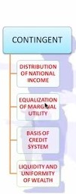
Contingent functions
Basis of economic theories
Distribution of NI
Efficiency and optimum allocation
Basis of credit
Other functions:
Measure of liquidity
Determination of solvency
Different uses

Slide 13
Importance and role of money
Money and the consumers
Money and the producers
Money and advanced payments
Money and social and economic change

Slide 14
Why we study money?
We study money due to following reasons:
Medium of exchange
Measure of value
Subdivision
Store of value
Investments / savings
Comparison of living standards
Banking institutions
Foreign investments
Public Finance / Government revenues

Slide 15
Concepts of money
There are three approaches to understand money.
General acceptability
Descriptive approach
Alternation approach
Traditional view
Monetarist view
Liquidity approach

Slide 16
Money and national income and product
National income:
The total amount if money earned within a country.
Major classes of national income are:
Wages and salaries
Gross trading profits
Capital consumption allowance
Income of the self employed
Imputed income etc.
Product:
An article or substance that is manufactured or refined for sale.

Slide 17
Economic disadvantages of money
Class conflict
Trade cycle
Inflation
Debt traps
Domination of multi nationals
Environmental degradation
The credit economy

Slide 18
Currency devaluation in Pakistan
An increase deficit
Fall in foreign exchange reserve
Meeting the pressures of payments

Slide 19
Distinction between money and credit
Money | Credit
A current medium of exchange in the form of coins and banknotes; coins and banknotes collectively. | Credit is a contractual agreement in which a borrower receives something of value now and agrees to repay the lender at some date in the future, generally with interest
A cash transaction is a transaction where payment are settled immediately. | A payment for a credit transaction is settled at a later date.
Paying in cash means you never have to pay interest. | Credit cards give you spending power without the inconvenience of carrying around cash.

Slide 20
Money as an asset
Money is financial asset because the value of the asset itself doesn't come from the paper or metal it is printed on; it comes from the faith and credit of the government that issued that money.
Without a common medium of exchange, we would all need to barter with one another, trading whatever goods and services we have for something else we need, or trade what we have for some thing else we could then trade again with someone else who has what we need

Slide 21
Concept of near money
Near money is an economics term describing non-cash assets that are highly liquid, such as bank deposits, certificates of deposit (CDs) and Treasury Bills. Near money refers to assets that can be quickly converted into cash.
Examples of near money are as follows:
Savings accounts.
Money funds.
Bank time deposits (certificates of deposit)
Government treasury securities (such as T-bills)
Bonds near their redemption date.
Foreign currencies, especially widely traded ones such as the US dollar, euro or yen.

Slide 22
Principles and method of note issue
Principals
1.Currency principals:
Central bank of the country should keep 100% gold for every note issued. It means full convertibility of notes.
2.Banking principals
No need to keep 100% of gold or silver against notes issued. The note issued in the country should be according to the needs of trade and industry

Slide 23
Method of note issue:
Fixed fiduciary issue
Under fixed fiduciary system, the government fixes a fixed amount of notes without keeping any metallic reserve. But this portion of currency must be backed by government securities, which is called fiduciary Limit.
Proportional reserve system:
In Proportional Reserve System (PRS), certain proportion or percentage of the reserves has to maintained in the form of precious metals like Gold. The remaining part of the reserves is to be kept in specific assets such as Government Securities and Commercial Bills.
Minimum reserve system:
Minimum Reserve System, the RBI has to keep a minimum reserve of Rs 200 crore comprising of gold coin and gold bullion and foreign currencies. ... Under the Minimum Reserve System, RBI can issue unlimited amount of currency by keeping the reserve.

Slide 24
Method of note issue in Pakistan
Method Of Note Issue Adopted In Pakistan:-
Pakistan has used proportional reserve system up to December 1965. Under this method 30% was to be kept as reserve in the form of gold coin, gold, silver bullion and approved foreign exchange. The balance was covered by rupee coin and government security After 1965. State Bank of Pakistan adopted fixed minimum reserve system Under this system the bank has to keep only legally fixed amount of minimum reserve in gold, or silver. Moreover the government in consultation with the State Bank can alter it.

